Slide 1
SysEng 5211 Computational Intelligence
Steven Corns
Neural Networks

Slide 2
Neural Networks
Mimics neurons in the brain
Creates a parallel architecture of simple computational devices

Slide 3
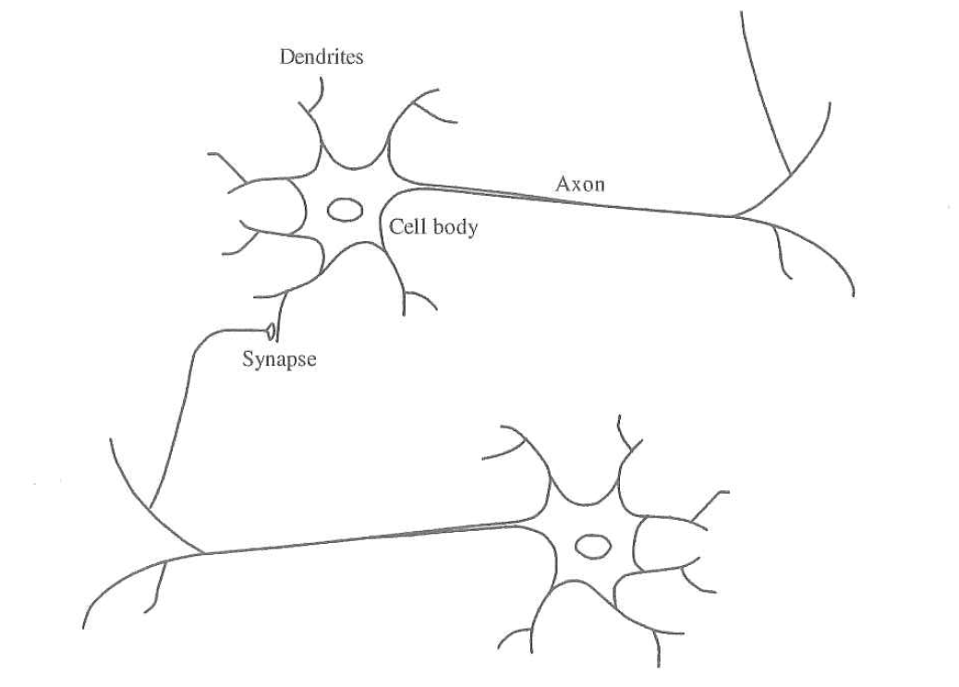
Neural Networks
Simplest structure is a neuron
From Keller, Liu, and Fogel, 2016

Slide 4
Artificial Neuron
Information processing unit of a neural network
Takes inputs and provides an output based on weights

Slide 5
Artificial Neuron Elements
Set of synapses
Connecting links to inputs
Adder
Sums the weighted synaptic strengths
Activation function
Limits the amplitude of the neuron output
Bias
Increases or decreases the net input of the activation function

Slide 6
Artificial Neural Networks
Artificial neurons are used to create the network (ANN)
Bias
W₁
W₂
W₃
W₄
W₅

Slide 7
Signal Flow Rules
Signals flow only in the direction of the arrows in a link
A node signal is the algebraic sum of all incoming signals
The node signal is transmitted to each outgoing link

Slide 8






Link types
Synaptic – linear input-output relation
Activation – nonlinear input-output relation
$$w_{kj}$$
$$x_{j}$$
$$y_{k}=w_{kj}x_{j}$$
$$ϕ(∙)$$
$$x_{j}$$
$$y_{k}=ϕ(x_{j})$$

Slide 9
Architecture Graph Rules
Source nodes provide input signal to the graph
Each neuron represented by a computation node
No weights associated with links (value comes from source)

Slide 10
Rosenblatt’s Perceptron
Looking at Rosenblatt’s Perceptron
Bias
W₁
W₂
W₃
W₄
W₅

Slide 11

Rosenblatt’s Neuron
Maps an input x to a binary via an f(x)
Decides which side of the y axis (positive or negative)
$$f\left(x\right)=\left\{\begin{matrix}1, if w∙x+b>0 \\ 0, otherwise\end{matrix}\right.$$

Slide 12
Rosenblatt’s Neuron
Looking at Rosenblatt’s Perceptron
b
W₁
Hard Limiter
W₂

Slide 13



Rosenblatt’s Neuron
$$x_{2}$$
Class 2
$$x_{1}$$
Class 1
$$w_{1}x_{1}+w_{2}x_{2}+b=0$$

Slide 14
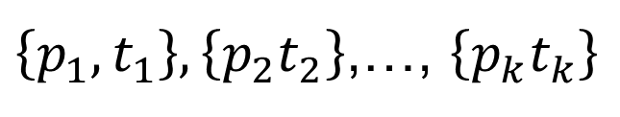
Training the Perceptron
Training is done by presenting correct data to the algorithm
Where p_{i} is the input and t_{i} is the matching output
$\left\{p_{1},t_{1}\right\},\left\{p_{2}t_{2}\right\}$,…, $\left\{p_{k}t_{k}\right\}$

Slide 15
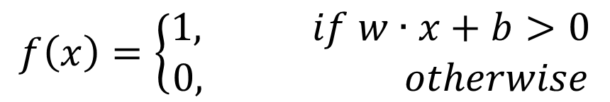
Example
Using the data:
Using
$$\left\{p_{1}=\left[\begin{matrix}2 \\ 3\end{matrix}\right],t_{1}=1\right\},\left\{p_{2}=\left[\begin{matrix}−1 \\ 0\end{matrix}\right]{,t}_{2}=0\right\},\left\{p_{3}=\left[\begin{matrix}1 \\ 2\end{matrix}\right]{,t}_{k}=1\right\}$$
$$f\left(x\right)=\left\{\begin{matrix}1, if w∙x+b>0 \\ 0, otherwise\end{matrix}\right.$$

Slide 16
Example

Slide 17


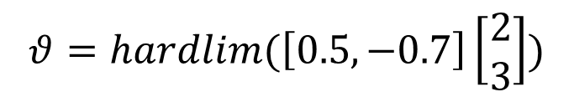
Example
Let ₁w^{T}= [0.5,-0.7]:
$$θ=hardlim(\text{1}\text{w}\text{T})$$
$$θ=hardlim(\left[0.5,−0.7\right]\left[\begin{matrix}2 \\ 3\end{matrix}\right])$$
$$θ=hardlim\left(−1.1\right)=0$$

Slide 18
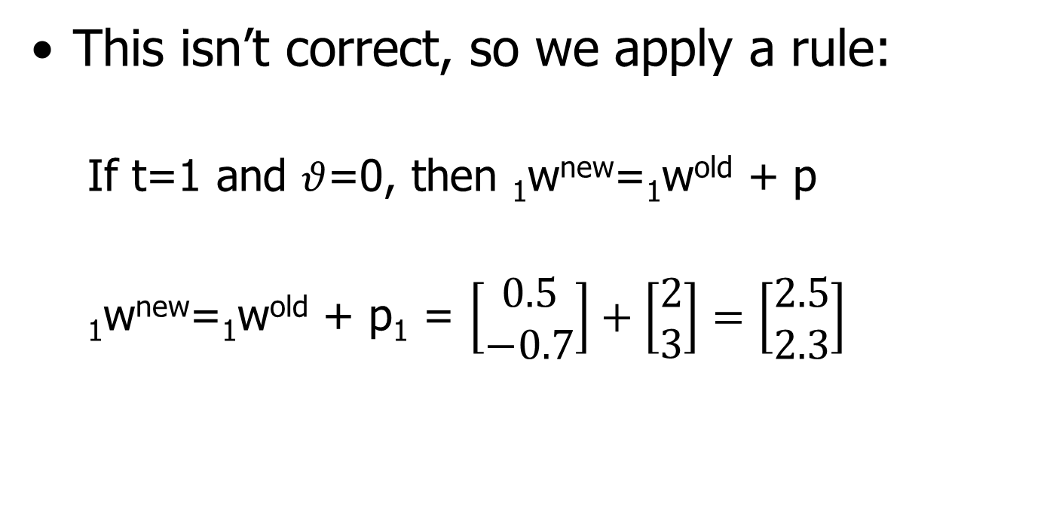
Example
This isn’t correct, so we apply a rule:
If t=1 and $θ$=0, then ₁w^{new}=₁w^{old} + p
₁w^{new}=₁w^{old} + p₁ = $\left[\begin{matrix}0.5 \\ −0.7\end{matrix}\right]+\left[\begin{matrix}2 \\ 3\end{matrix}\right]=\left[\begin{matrix}2.5 \\ 2.3\end{matrix}\right]$

Slide 19

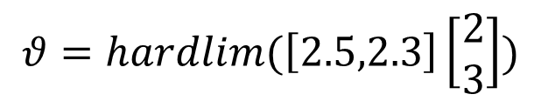
Example
Now ₁w^{T}= {2.5,2.3]:
$$θ=hardlim(\text{1}\text{w}\text{T})$$
$$θ=hardlim(\left[2.5,2.3\right]\left[\begin{matrix}2 \\ 3\end{matrix}\right])$$
$$θ=hardlim\left(11.9\right)=1$$

Slide 20

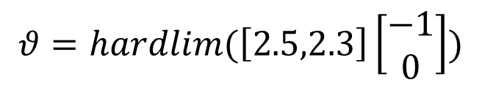
Example
For the second input:
$$θ=hardlim(\text{1}\text{w}\text{T})$$
$$θ=hardlim(\left[2.5,2.3\right]\left[\begin{matrix}−1 \\ 0\end{matrix}\right])$$
$$θ=hardlim\left(−2.5\right)=0$$
OK

Slide 21
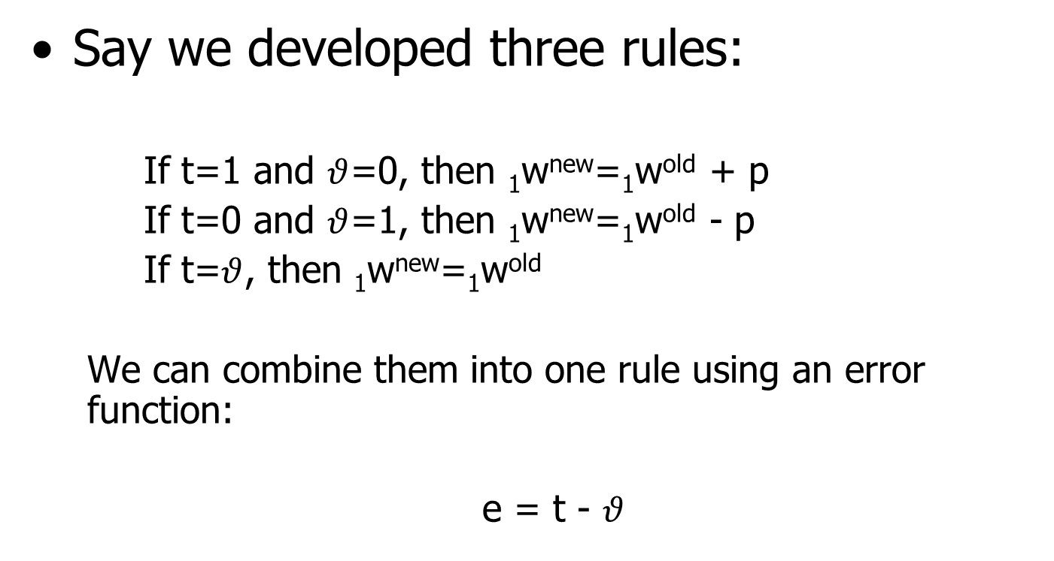
Unified Learning Rule
Say we developed three rules:
If t=1 and $θ$=0, then ₁w^{new}=₁w^{old} + p
If t=0 and $θ$=1, then ₁w^{new}=₁w^{old} - p
If t=$θ$, then ₁w^{new}=₁w^{old}
We can combine them into one rule using an error function:
e = t - $θ$

Slide 22
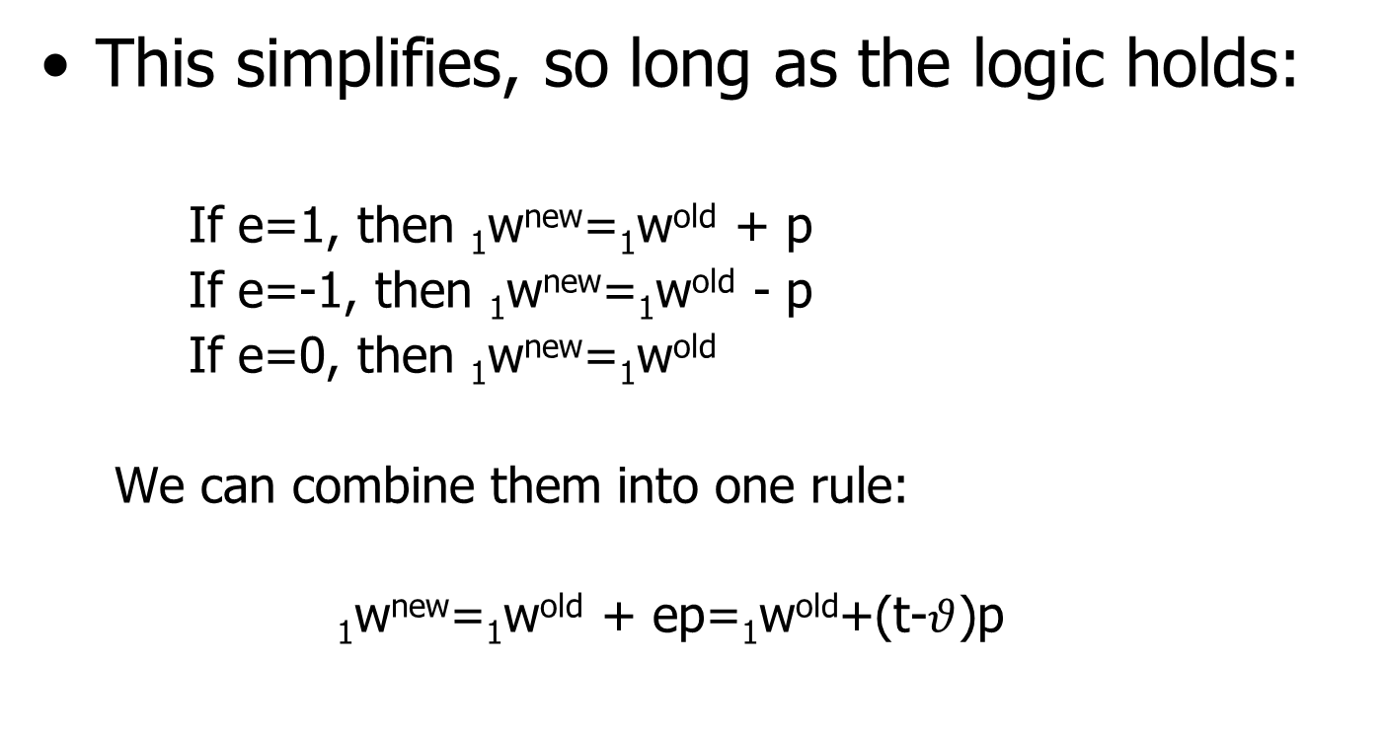
Unified Learning Rule
This simplifies, so long as the logic holds:
If e=1, then ₁w^{new}=₁w^{old} + p
If e=-1, then ₁w^{new}=₁w^{old} - p
If e=0, then ₁w^{new}=₁w^{old}
We can combine them into one rule:
₁w^{new}=₁w^{old} + ep=₁w^{old}+(t-$θ$)p

Slide 23
Unified Learning Rule
This can be applied to multiple perceptrons by using matrix notation:
₁w^{new}=₁w^{old} + ep^{T}
These unified rules also apply to bias:
b^{new}=b^{old}+e

Slide 24
Activation Functions
Activation functions drive the output of the neuron
There are two common activation functions:
Threshold function
Sigmoid function

Slide 25
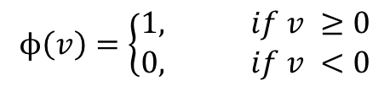

Threshold Function
Converts inputs into a binary response
Matches biological neuron
Step function
This output is based on the evaluation of the computation neuron:
$$ϕ\left(v\right)=\left\{\begin{matrix}1, if v ≥0 \\ 0, if v <0\end{matrix}\right.$$
$$v=\sum_{i=0}^{n}{w_{i}x_{i}+b}$$

Slide 26
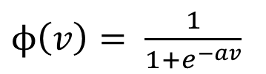
Sigmoid Function
More common form of activation function
Is an increasing function, such as logistic function:
This can be modified to address different situations, such as allowing negative values
$ϕ\left(v\right)= \frac{1}{1+e^{−av}}$

Slide 27
Multilayer Neural Networks
Single layer neural networks are limited to linearly separable problems
By introducing additional layers, general nonlinear mapping from input to output can be performed

Slide 28
Multilayer Neural Networks
Each neuron in the network has a differentiable and nonlinear activation function.
Network contains one or more hidden layers.
Hidden layers not visible to input or output layers
Network is fully connected between layers.

Slide 29
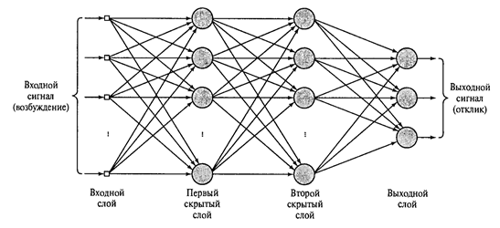
Multilayer Neural Networks
From http://bashny.net/t/en/155988

Slide 30
Multilayer Neural Networks
Operates on two pass (propagation) method
Signal is propagated through the network applying weights
Outputs are used to generate an error function to adjust weight
The error function works backward from the output (Backpropagation)

Slide 31
Backpropagation
Error function is analyzed as a gradient optimization
Activation functions are differentiable
Creating a fitness landscape from the weights would allow to solve using a gradient search

Slide 32
Backpropagation
The output field is a function of the input of the activation functions
Where n is the number of inputs applied to neuron j
The output is a function of this:
$$v_{j}(k)=\sum_{i=0}^{n}{w_{ij}(k)y_{i}(k)}$$
$$y_{j}(k)=ϕ_{j}(v_{j}\left(k\right))$$

Slide 33
Backpropagation
Using the desired output an error function can be found:
And define the instantaneous error as
$$e_{j}\left(k\right)=d_{j}\left(k\right)−y_{j}\left(k\right)$$
$$E_{j}\left(k\right)={\frac{1}{2}e2}_{j}\left(k\right)$$

Slide 34
Backpropagation
This allows us to derive a correction factor (Δw_{ji}(k)) to the weight
Found by taking the partial derivative of E(k) w.r.t. w_{ji}(k), which gives:
Where $α$ is learning rate parameter
Δw_{ji}(k)$=−α\frac{∂E(k)}{∂w_{ji}(k)}$

Slide 35
Backpropagation
The correction factor varies depending on the node:
$$\text{Δ}\text{w}\text{ji}\text{(}\text{k}\text{)}=\left\{\begin{matrix}αe_{j}\left(k\right){φ^{′}}_{j}\left(v_{j}\left(k\right)\right)y_{i}\left(k\right), if neuron j is an output node \\ α{φ^{′}}_{j}\left(v_{j}\left(k\right)\right)\sum_{1}{\left(e_{1}{φ^{′}}_{j}\left(v_{1}\left(k\right)\right)w_{1j}\left(k\right)\right)y_{i}\left(k\right)} ifneuron j is a hidden node\end{matrix}\right.$$

Slide 36
Backpropagation
Note that the local gradient for these functions is necessary:
so the correction can be written:
$δ\text{j}\text{(}\text{k}\text{)}=$ $e_{j}\left(k\right){φ^{′}}_{j}\left(v_{j}\left(k\right)\right) for output nodes$
$δ\text{j}\text{(}\text{k}\text{)}=$ ${φ^{′}}_{j}\left(v_{j}\left(k\right)\right)\sum_{1}{δ_{1}\left(k\right)w_{1j}\left(k\right) for hidden nodes}$
$$\text{Δ}\text{w}\text{ji}\text{(}\text{k}\text{)}=αδ\text{j}\text{(}\text{k}\text{)}y_{j}\left(k\right)$$

Slide 37
Learning Rate Parameter
The learning rate parameter drives the delta w function
Care should be taken in selecting $α$:
Too small, learning is too slow
Too large, network becomes unstable
$$\text{Δ}\text{w}\text{ji}\text{(}\text{k}\text{)}=\left\{\begin{matrix}αe_{j}\left(k\right){φ^{′}}_{j}\left(v_{j}\left(k\right)\right)y_{i}\left(k\right), if neuron j is an output node \\ α{φ^{′}}_{j}\left(v_{j}\left(k\right)\right)\sum_{1}{\left(e_{1}{φ^{′}}_{j}\left(v_{1}\left(k\right)\right)w_{1j}\left(k\right)\right)y_{i}\left(k\right)} ifneuron j is a hidden node\end{matrix}\right.$$

Slide 38
Learning Rate Parameter
Methods have been introduced to adjust this algorithm, such as a momentum term (β):
$$\text{Δ}\text{w}\text{ji}\text{(}\text{k}\text{)}=β\text{Δ}\text{w}\text{ji}\text{(}\text{k}\text{−1}\text{)}+αδ\text{j}\text{(}\text{k}\text{)}y_{j}\left(k\right)$$

Slide 39
Backpropagation Procedure
Initialize
Process training sample
Compute forward
Compute backward
Iterate

Slide 40
Neural Network Comments
Function approximaters
More training data is not necessarily a good thing
Overfitting
Cross validation can help
Training set and validation set

Slide 41
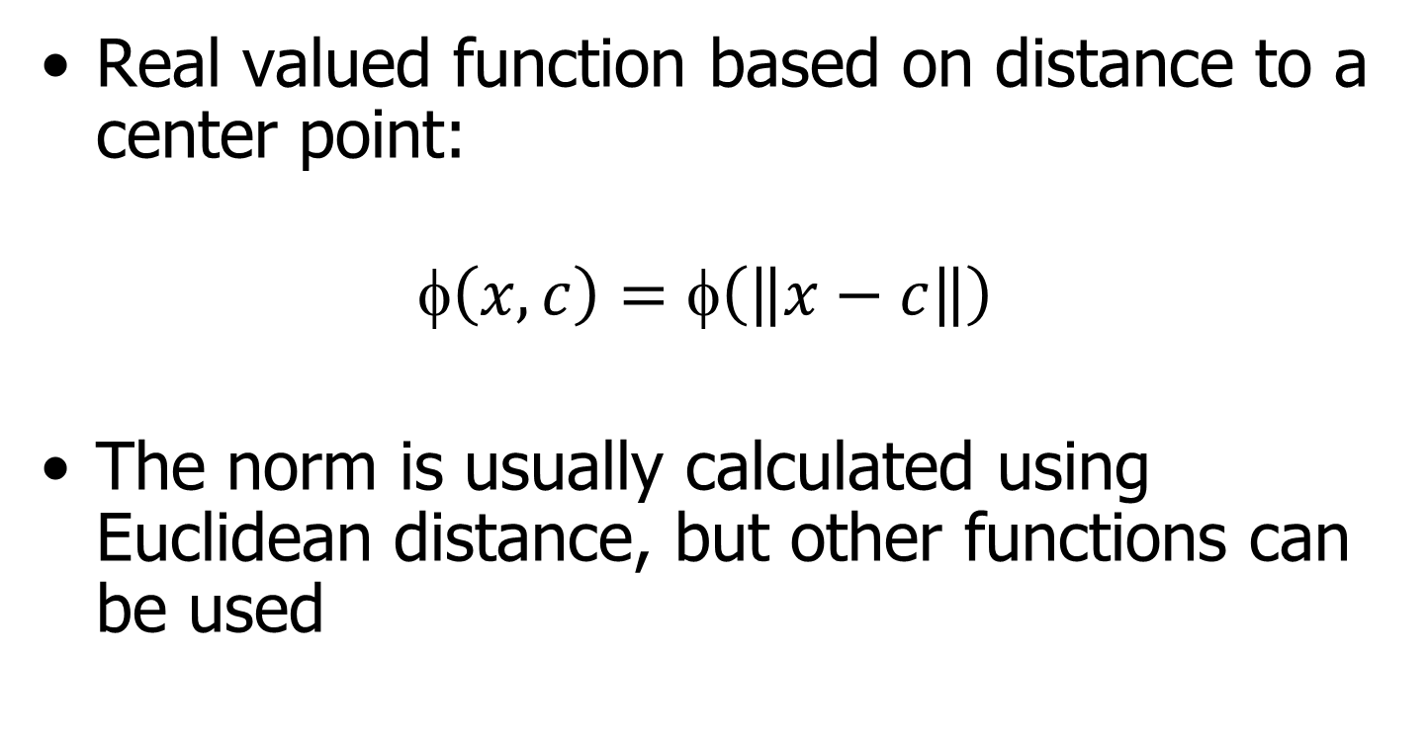
Radial Basis Functions
Real valued function based on distance to a center point:
$$\left(x,c\right)=φ\left(\left\|x−c\right\|\right)$$
The norm is usually calculated using Euclidean distance, but other functions can be used

Slide 42
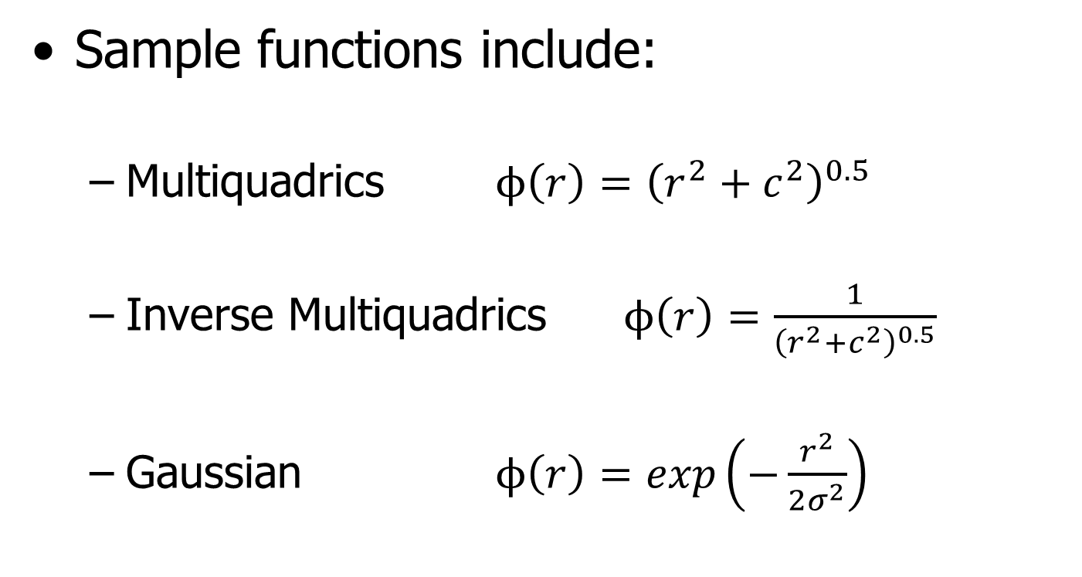
Radial Basis Functions
Sample functions include:
Multiquadrics $ϕ\left(r\right)={\left(r^{2}+c^{2}\right)}^{0.5}$
Inverse Multiquadrics $ϕ\left(r\right)=\frac{1}{{\left(r^{2}+c^{2}\right)}^{0.5}}$
Gaussian $ϕ\left(r\right)=exp\left(−\frac{r^{2}}{2σ^{2}}\right)$
Where c>0, σ>0, and r∈ℜ

Slide 43
Radial Basis Functions
When used for neural networks, the approach is similar to curve fitting in hyper-dimensional space.
This is represented by multivariable interpolation in high-dimensional space

Slide 44
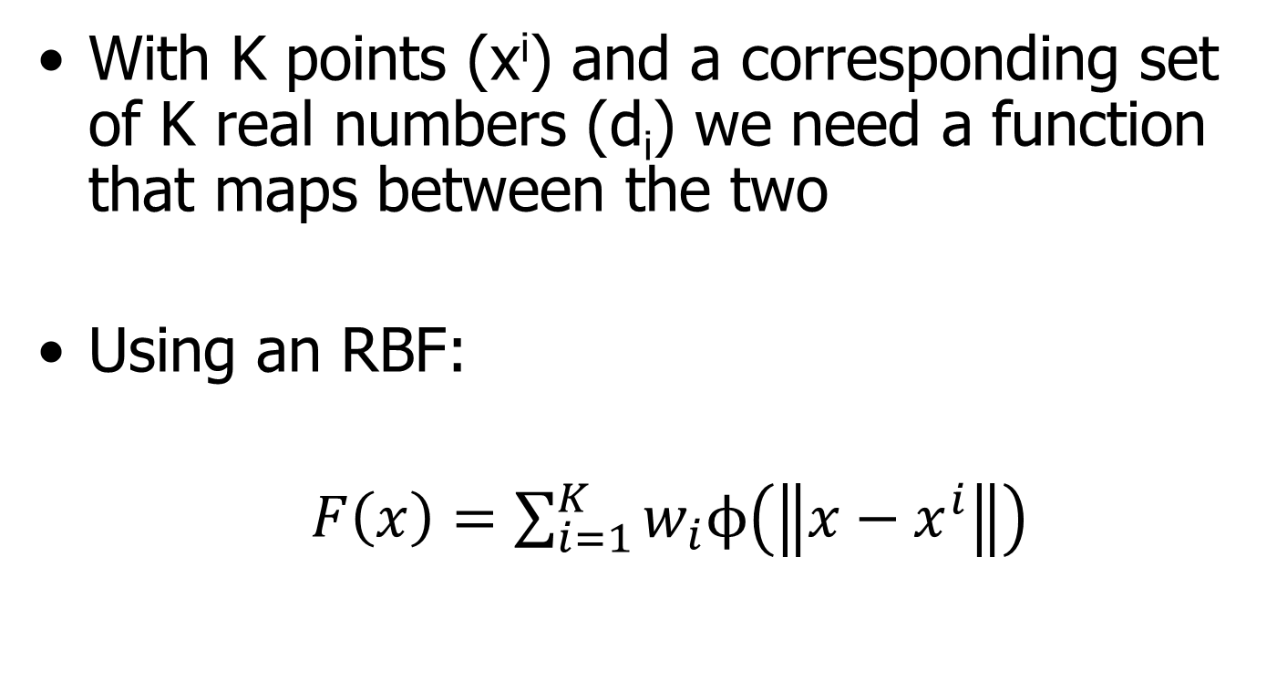
Radial Basis Functions
With K points (x^{i}) and a corresponding set of K real numbers (d_{i}) we need a function that maps between the two
Using an RBF:
$F\left(x\right)=\sum_{i=1}^{K}{w_{i}ϕ\left(\left\|x−x^{i}\right\|\right)}$
$$F\left(x^{i}\right)=d_{i}$$

Slide 45
Radial Basis Functions
$$ϕ_{ji}=ϕ\left(\left\|x^{j}−x^{i}\right\|\right)$$
Setting
Combining these:
$$\left[\begin{matrix}\begin{matrix}ϕ_{11} & ϕ_{12} \\ ϕ_{21} & ϕ_{22}\end{matrix} & ⋯ & \begin{matrix}ϕ_{1K} \\ ϕ_{2K}\end{matrix} \\ \begin{matrix}⋮ & ⋮\end{matrix} & ⋮ & ⋮ \\ \begin{matrix}ϕ_{K1} & ϕ_{K2}\end{matrix} & ⋯ & ϕ_{KK}\end{matrix}\right]\left[\begin{matrix}w_{1} \\ \begin{matrix}w_{2} \\ ⋮\end{matrix} \\ w_{K}\end{matrix}\right]=\left[\begin{matrix}d_{1} \\ \begin{matrix}d_{2} \\ ⋮\end{matrix} \\ d_{K}\end{matrix}\right]$$

Slide 46
Radial Basis Functions
This allows us to solve the weight vector using the inverse matrix:
w$=ϕ^{−1}d$

Slide 47
RBF Network (K=4)
Each of these is a RBF
w₁
w₂
Output y = F(x)
w₃
w_{K}
In practice, the hidden layer
size is based on the training
data and less than K (S<K)
Hidden layer
of size K
Input layer
of size n₀

Slide 48
Radial Basis Functions
If there is no noise in the training sample ({x^{i},d_{i}} from 1 to K), the input vector can be used to find the center of the RBFs
A Hybrid Learning Process is necessary in the presence of noise

Slide 49
Hybrid Learning Process
Partition the data into clusters
Use S clusters
Let ${\left\{c_{j}\left(k\right)\right\}}_{j=1}^{S}$ be the centers of the RBFs
Iterate to find true centers (can use k-means)

Slide 50
Hybrid Learning Process
Initialization – set initial center to random value
Sampling – select a sample vector from the data and input to network
Similarity matching – for the input vector, calculate center as minimum distance from center
Updating – adjust centers using a learning rate parameter to gradually move center away from previous center
Continuation – iterate until updates become negligible

Slide 51
Hybrid Learning Process
An error function is then used to determine the weights of the RBF network:
$$e_{i}\left(k\right)=d_{i}\left(k\right)−\sum_{j=1}^{S}{w_{j}\left(k\right)ϕ_{ij}}$$
Using a gradient calculated from the instantaneous error, we get the update rule:
$$w_{j}\left(k+1\right)=w_{j}\left(k\right)+∝\sum_{i=1}^{K}{e_{i}\left(k\right)ϕ_{ij}}$$

Slide 52
Support Vector Machines
Used in classification and regression
Created a hyperplane in multi-dimensional space to separate data
Non-linear classification can be done by mapping inputs into higher dimensional spaces
Typically uses kernels

Slide 53
Kernels
A kernel (k(x)) is continuous, bounded, and a real function of x that is symmetric about the origin (where it has it’s maximum value)
The volume underneath a kernel is unity
These kernels are used as mapping functions into feature space to add higher dimensions

Slide 54
Support Vector Machines
Kernels are selected to match the problem being solved
Distance metrics similar to RBFs are used to create a separation (margin) between a hyperplane described by the created points and the data clusters

Slide 55
Linear Support Vector Machine
Given a set of n points in the form $\left(\vec{x_{1}},y_{1}\right),…,\left(\vec{x_{n}},y_{n}\right)$ where $\vec{x_{i}}$ is a vector of real points and $y_{i}$ is a classification (say either 1 or -1)
Create a hyperplane that separates the data points with the greatest margin

Slide 56
Example

Slide 57
Example

Slide 58
Support Vector Machines
This is satisfied by identifying a set of points ($\vec{x_{i}}$) where:
$\vec{w}∙ \vec{x}−b=0$
Where $\vec{w}$ is the normal vector to the hyperplane and b is the offset from the origin

Slide 59
Support Vector Machines
Margins can also be enforced by modifying this equation:
$$\vec{w}∙ \vec{x}−b=1 and \vec{w}∙ \vec{x}−b=−1$$
For linearly separable data

Slide 60
Moving Forward
Next week:
Applications in Numerical Analysis
And then:
Supervised and unsupervised learning

Slide 61
Program Completed
Missouri University of Science & Technology
© 2003 Curators of University of Missouri

